Slide 1

Welcome to:
Thursday, September 22nd, 2016
Broun Hall Room 235

Slide 2
Introduction
Founded in 2006 by the Auburn University ECE Department
Acts as a “makerspace” that provides a place for students to work collaboratively on projects.
Provides the space, tools, and some resources for these projects.
No prior experience is required.
Great for students of all ages and majors.
Can act as a pathway to get involved in Undergraduate Research.

Slide 3


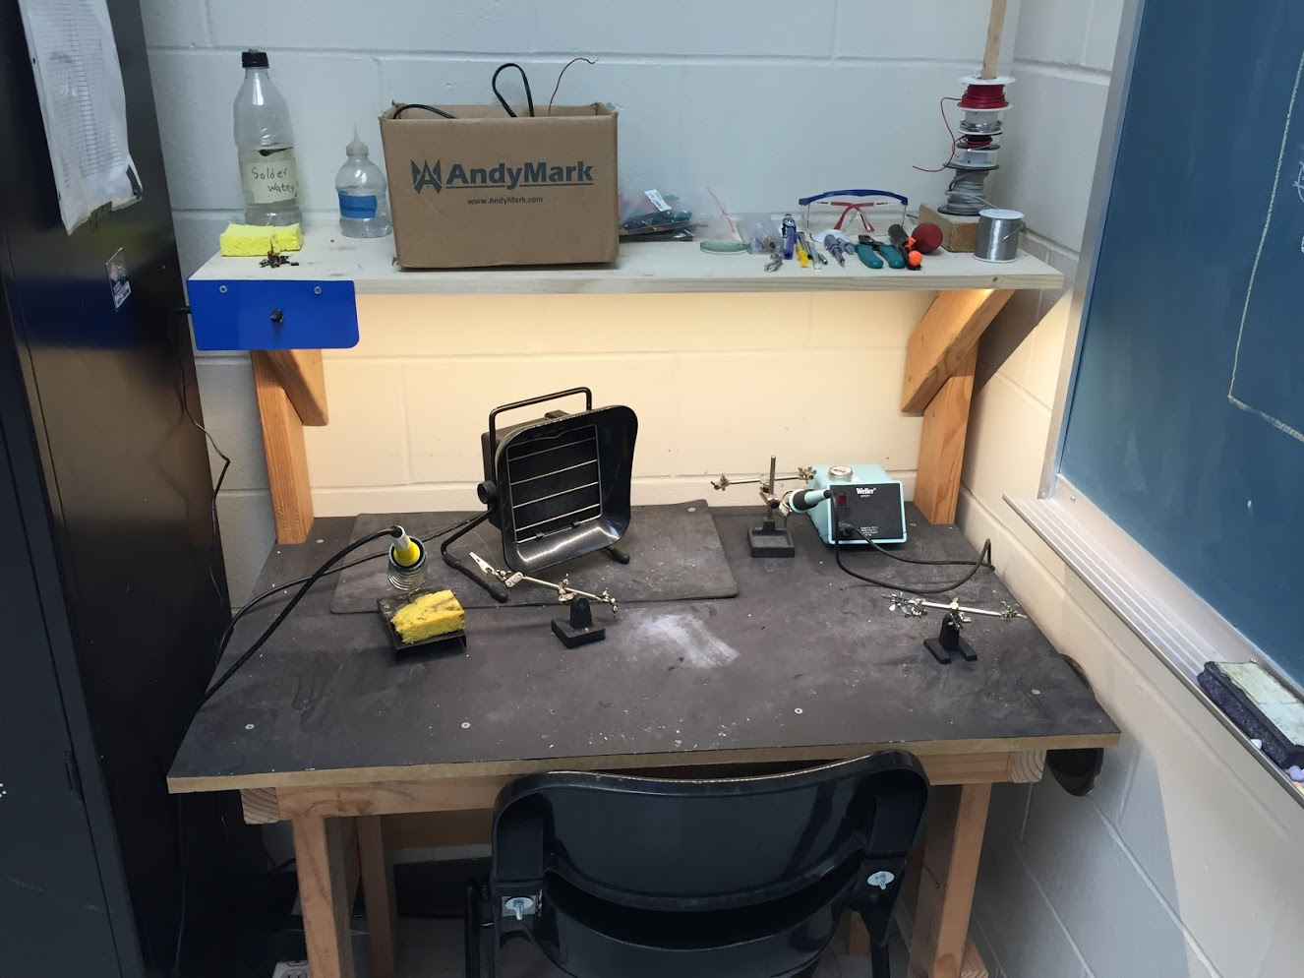
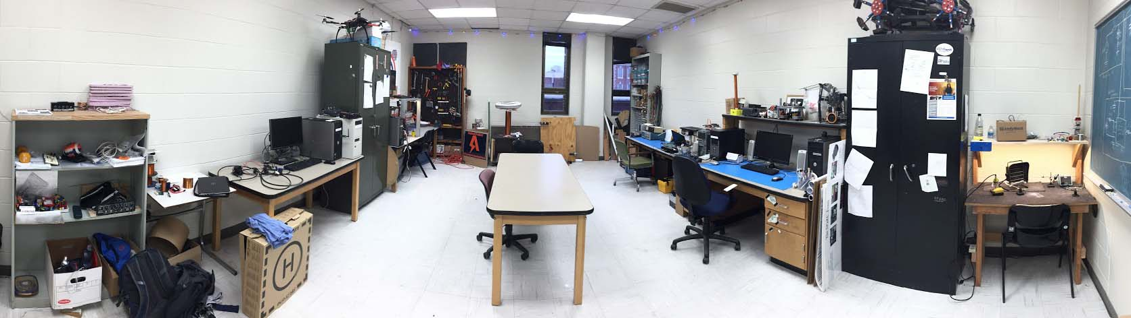
Our Lab
Broun Hall
Room: 367

Slide 4
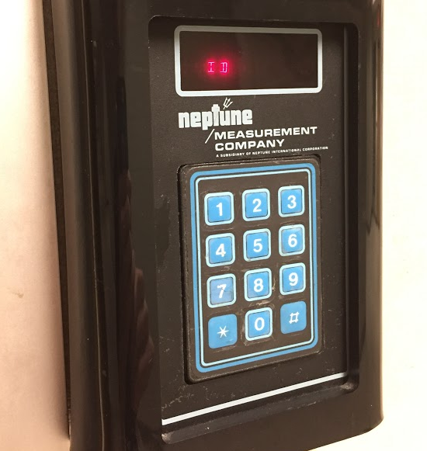
How to become a Member
Log 5 constructive hours in the lab
Write the times on the sheet on the cabinet on the left side of the room.
Contact our Secretary:
William Crubaugh
Email: wcc0023@auburn.edu
Then visit Autry May to get Code Access
Office: Broun Hall Room 252
Email: eceshop@auburn.edu
You will be given code access code that will give you 24/7 access to Broun 367 and Broun Hall.

Slide 5
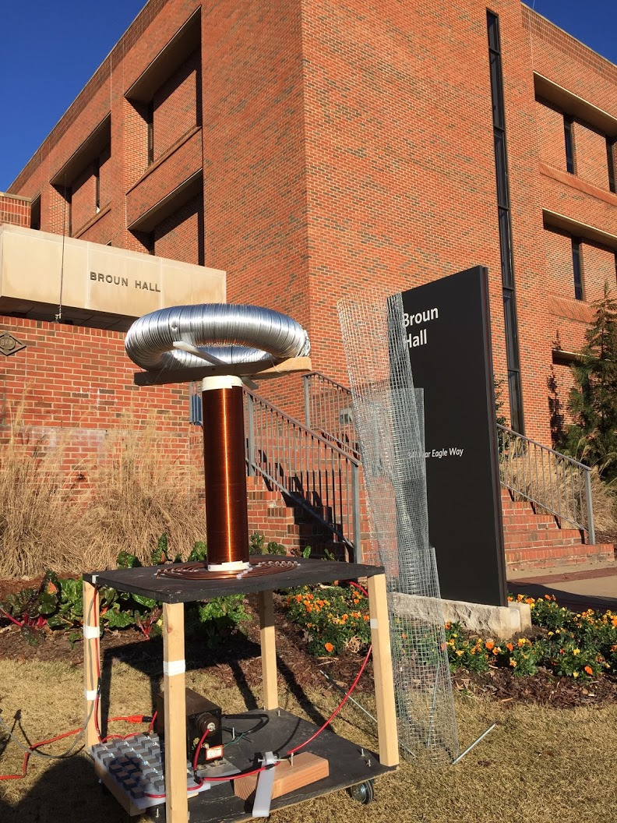
Outreach Events
Outreach Coordinator- Jack Thomas jet0024@auburn.edu
War Eagle BEST Robotics Competition
October 8th, 2016
https://docs.google.com/forms/d/e/1FAIpQLSfqpxiz0g8yq0XAby3W-UsmvRN2_1Ku0nfGDU5F-r-Vj3ZCHQ/viewform
Sanford Middle School in Opelika, AL STEM Event
Thursday October 20 and Friday October 21 8am-2:35pm
Free Breakfast and Lunch
SCORE Robotics Education Program- New program starting this semester
E-Day- Late February or early March
IEEE Sumo Robotics Competition (with local middle and high schools)- Spring 2017
E-Day 2016 Tesla Coil Demonstration

Slide 6
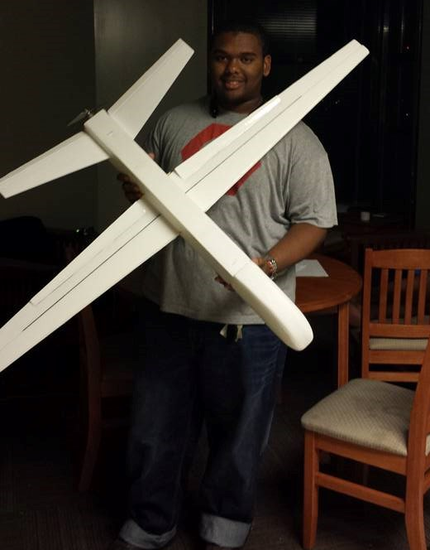
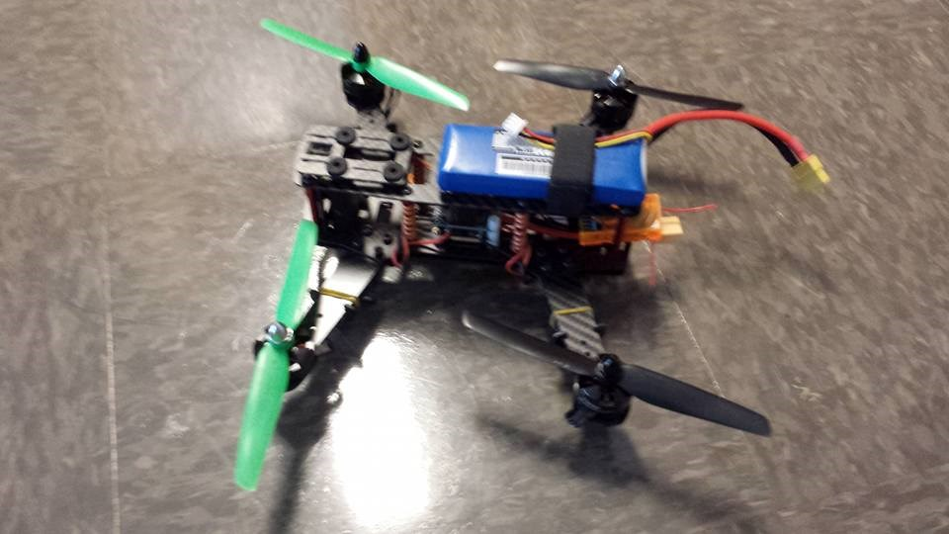
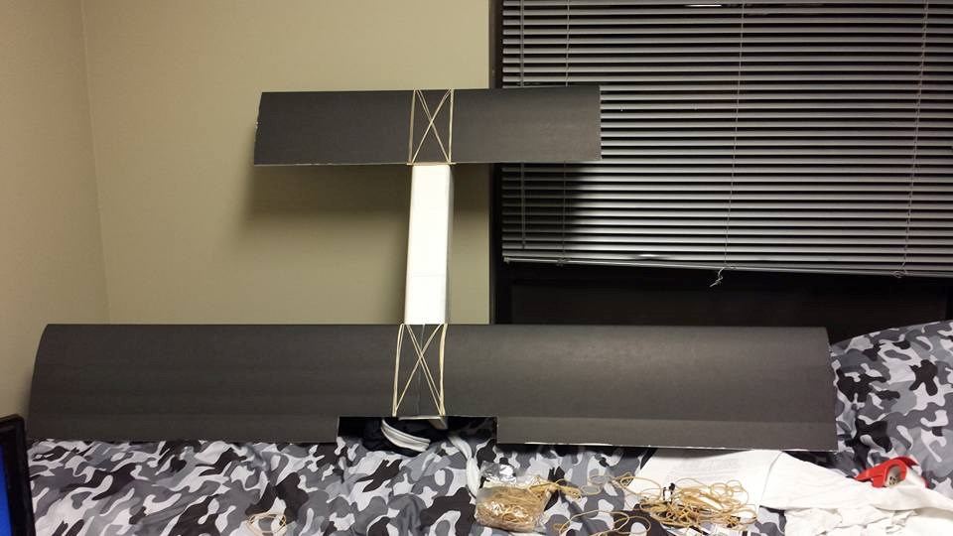
RC Hobbyist Club (RCHC)
Teaches 3D design, construction and control of RC airplanes, multi-copters, cars, and boats.
Designed to need no prior experience.
Functions very similar to SPARC
Meetings:
3-4 in Broun 235
Dues
$10 per semester
Club President
Joshua Parker jcp0048@auburn.edu

Slide 7
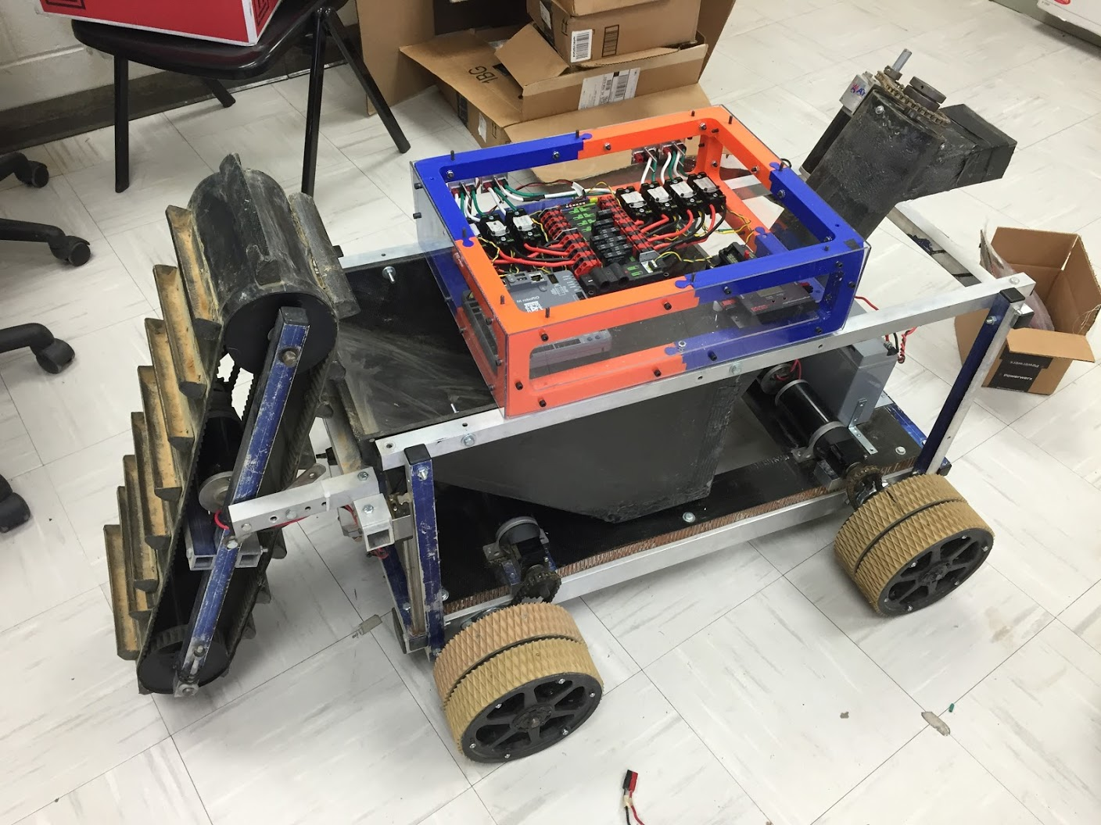
Projects: NASA Robotics Mining Competition
A 3rd Year Robotics team that designs and builds a robot
collects simulated Martian soil in a small arena
dispenses it into a small bin on the other side of the arena.
Can be remotely controlled or for bonus points autonomously controlled
Competition is held at the Kennedy Space Center this year from May 22nd-26th, 2017
Part of Auburn’s SPACE Club and affiliated with SPARC.
Team Lead:
Jeremy Frasher jjf0010@auburn.edu
Meetings:
Mondays 6:15 PM
2016 NASA RMC Robot

Slide 8
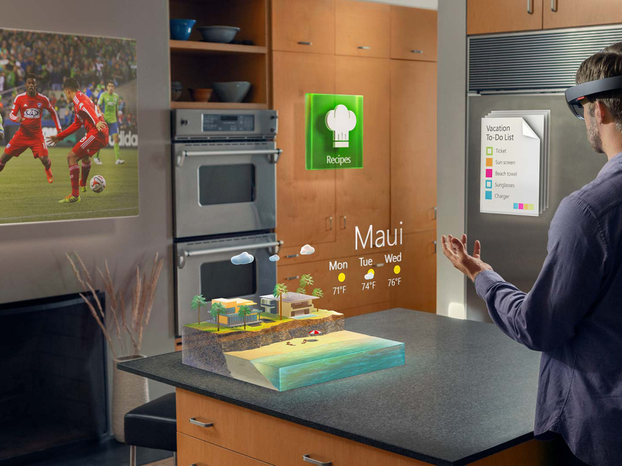
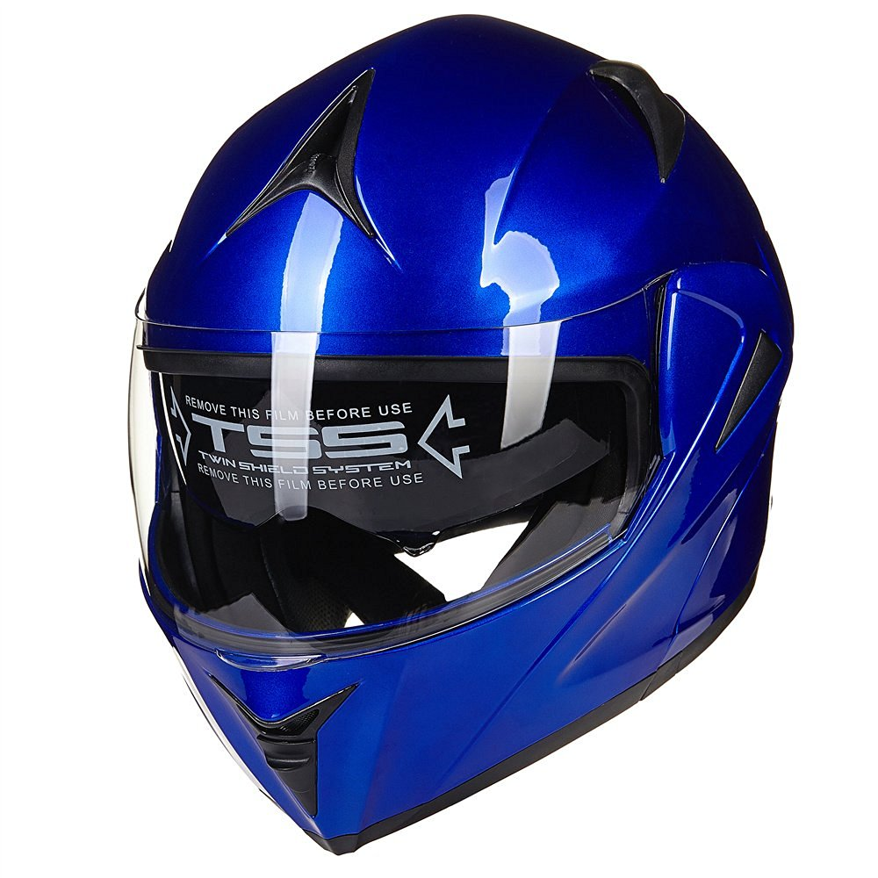
Projects: Augmented Reality Helmet
Create a augmented reality helmet.
Possibly using dual projector or reflected LCD’s
Similar to Microsoft Holo Lens
Possible Users of this Technology
Motorcyclists
Race Car Drivers
Astronauts
Soldiers
Fighter Pilots
Proposed Capabilities
Rear view
GPS directions
Music abilities
Team Lead:
Noah Niedzwiecki nmn0005@auburn.edu
Meetings:
Wednesday 5pm-6pm
Rendering of Microsoft Hololens
Possible Helmet

Slide 9
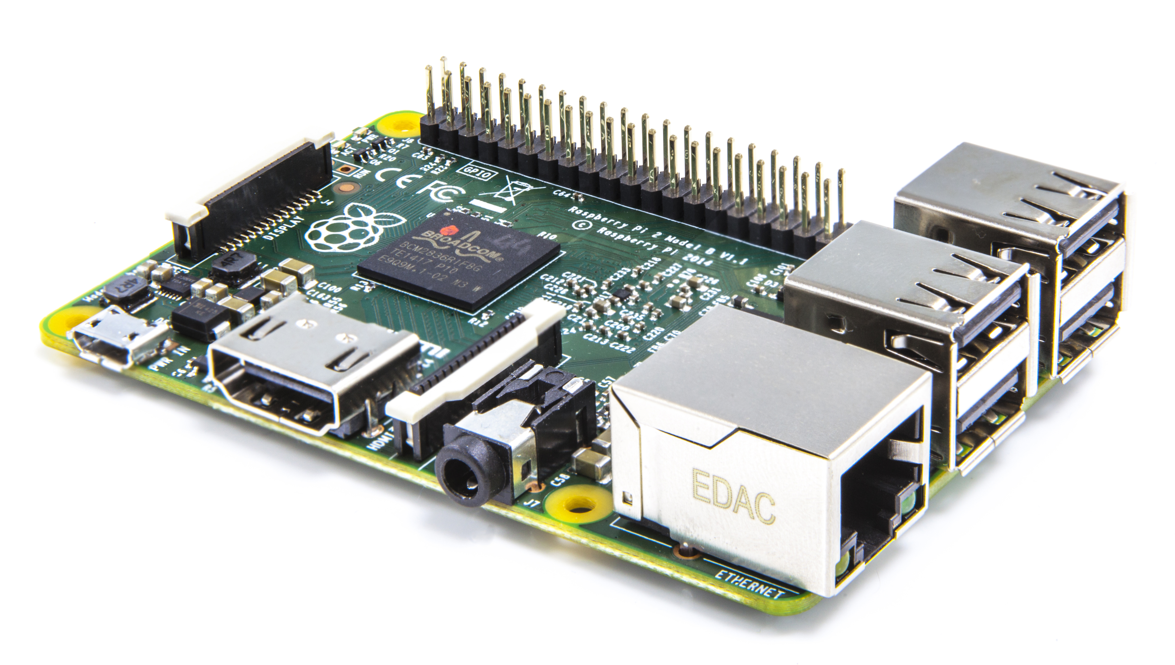

Projects: Automated Lab
Create an automated lab assistant.
Will be voiced controlled.
Will allow door to be unlocked temporarily remotely to allow new members access to the lab.
Great project for new members.
Team Lead:
Josh Jablonowski jdj0019@auburn.edu
Meetings:
Wednesdays 6:00pm-7:00pm
Location- SPARC Lab Broun 367
Raspberry Pi
Arduino Uno

Slide 10
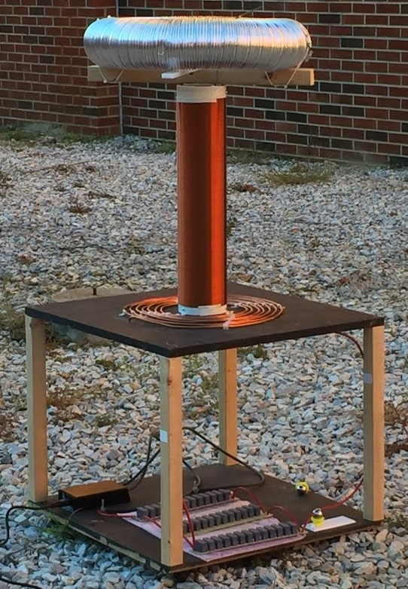
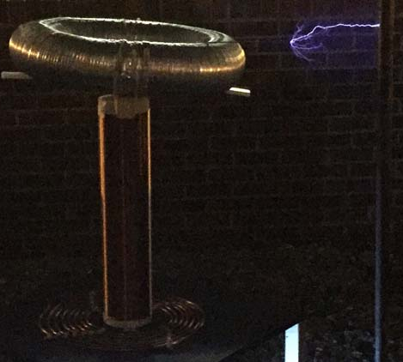
Projects: Tesla Coil
Last year we created a spark gap Tesla Coil.
It generated 400,000 volts of electricity
Goals this year:
Enhance it using homemade capacitors
Make it musical
Team Lead:
Matthew Castleberry mtc0030@auburn.edu
Meetings:
Not set

Slide 11
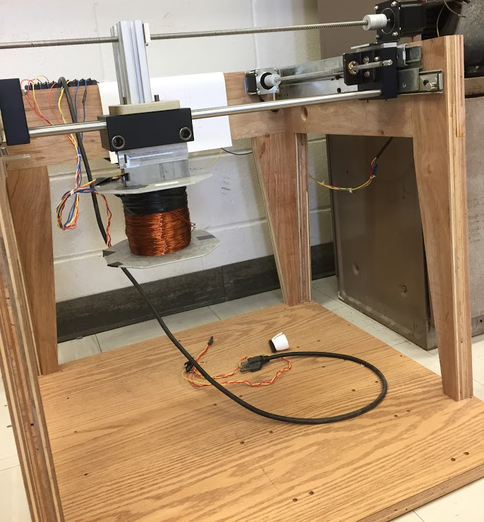
Projects: MAGLEV
Originally a senior design project involving magnetic levitation of small metal objects.
Uses 2 dimensional axes to move an electromagnet.
By varying frequency in coil, it can “sing” War Eagle
Also will be used for SCORE Crane Machine
Team Lead:
Shane Williams smw0031@auburn.edu
Meetings:
Not set

Slide 12
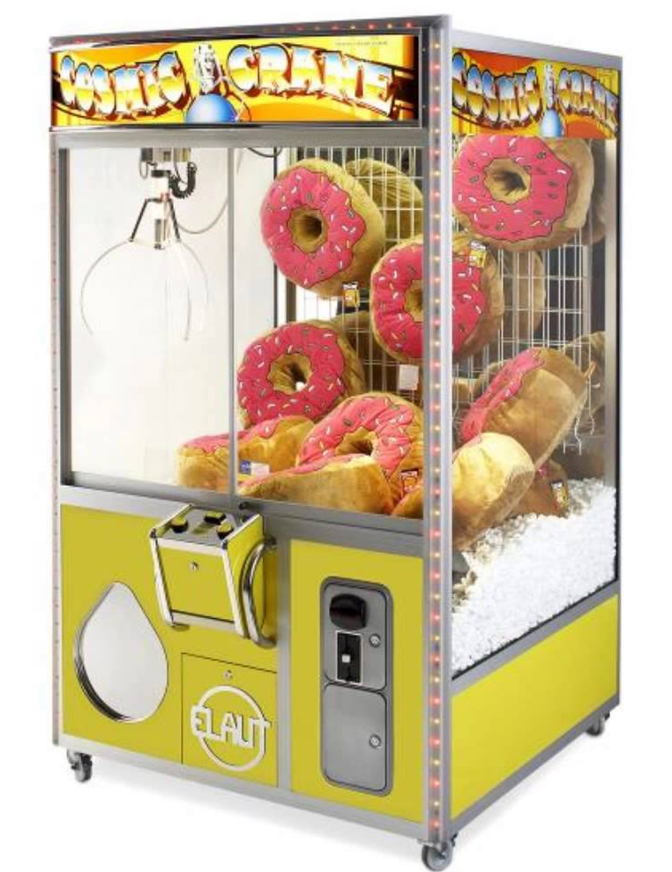
Projects: SCORE Crane Machine
Build a claw machine where “everyone wins”.
Will provide a fun way to distribute promotional items for the Southeastern Center of Robotics Education (SCORE).
Suspend a clawbot vertically, so people could use a joystick to manipulate it and pick up pens, squishy balls, etc. with the SCORE logo.
Team Facilitators:
Matthew Castleberry mtc0030@auburn.edu
Shane Williams smw0031@auburn.edu
Meetings:
Not Set

Slide 13
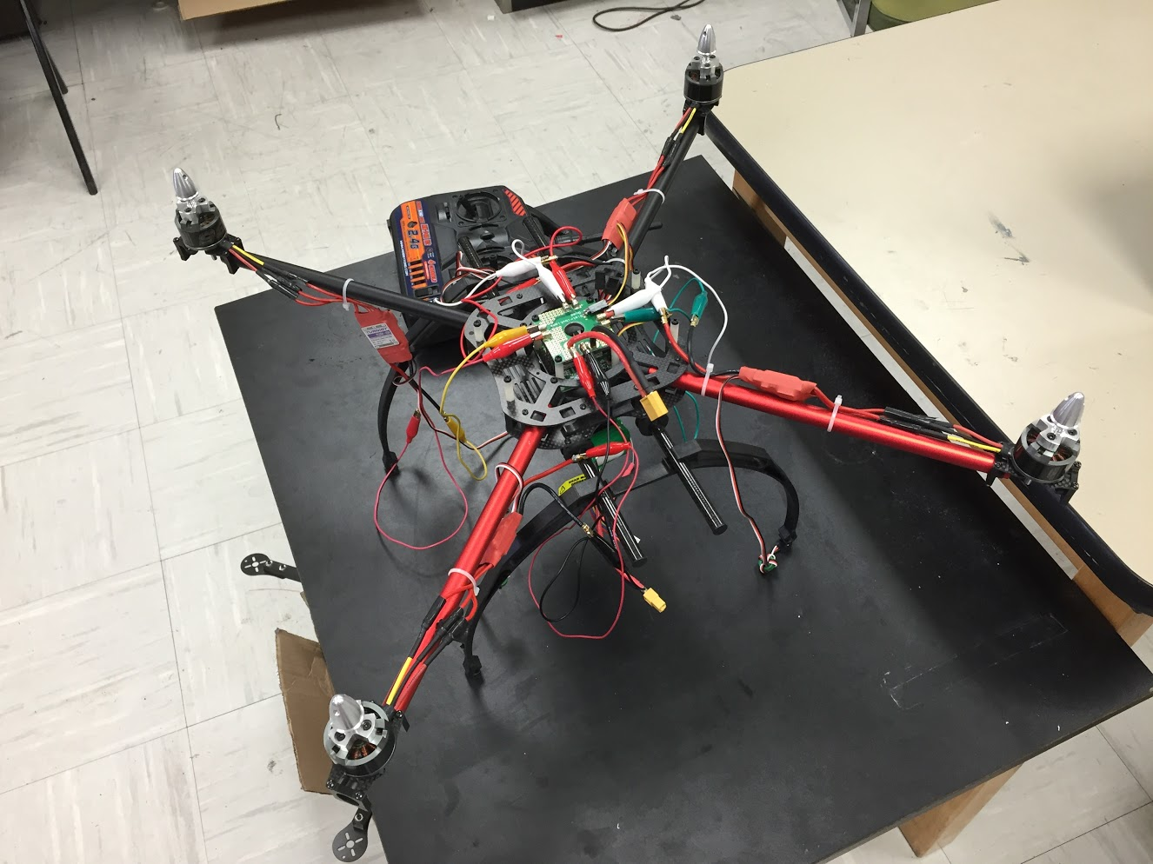
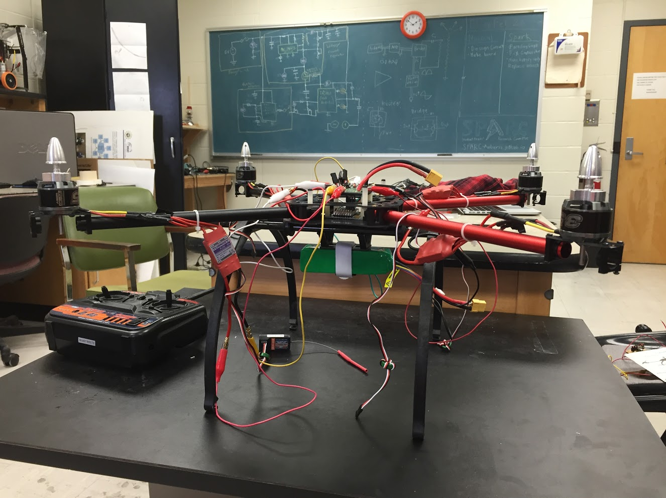
Projects: Quadcopter
A personal project by Josh.
3 years in the making
Joint project between SPARC and RC Hobbyist Club
Goals:
Solve an issue with one of the speed controllers and motors to enable the quadcopter to fly.
Possibly put an Arduino or Raspberry Pi on board for autonomous or semi-autonomous flight.
Team Lead:
Josh Jablonowski jdj0019@auburn.edu
Meetings:
Not set

Slide 14
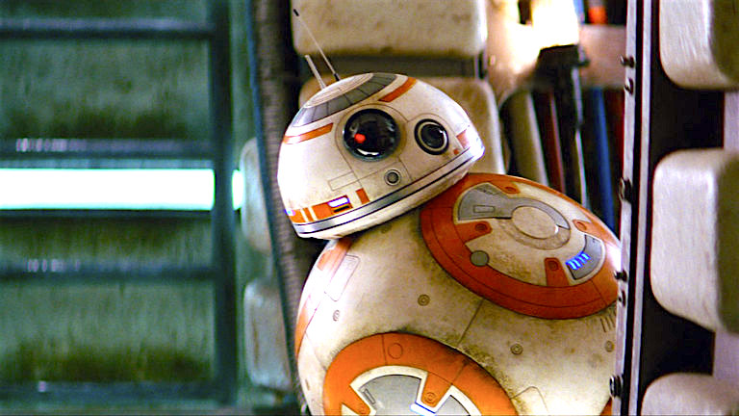
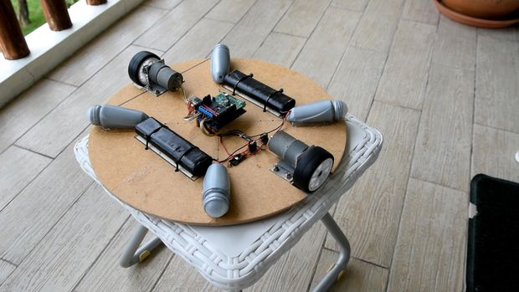
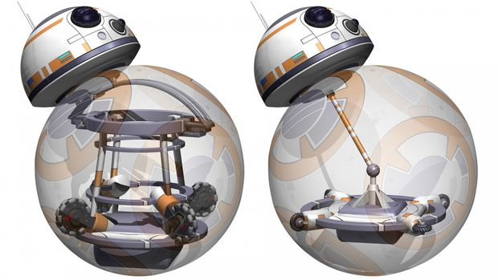
Projects: BB-8 robot
Build a robot that uses an internal mechanism to manipulate a ball to move around.
Also has semispherical “head” with sensors to detect surroundings.
A great E-Day project.
Based off of Instructables tutorial: http://www.instructables.com/id/DIY-Life-Size-Phone-Controlled-BB8-Droid/
Team Lead:
Not set
Meetings:
Not set

Slide 15

Review of Current Active Projects
NASA RMC
Augmented Reality Helmet
Automated Lab
MAGLEV
CORE Crane Machine
Quadcopter
BB-8 robot
Telsa Coil
Denotes that the project has an active GroupMe

Slide 16
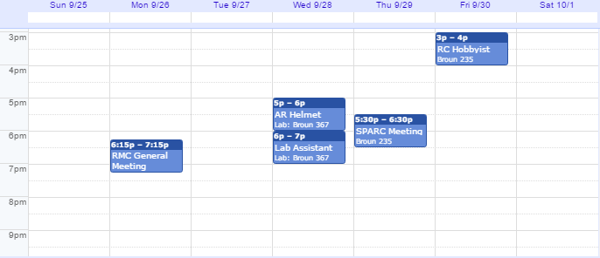
Meetings Schedule: Week of 9/26

Slide 17
Project Proposal Form
*Project Title: ____________________
*Project Description: ______________
____________________________________
Proposal Date: __/__/__
Expected Finish Date: __/__/__
*Funding Needed (Yes/No): __________
Proposed Budget: ___________________
*Project Lead: _____________________
Other Members: _____________________
For completion by an officer and the advisor:
Officer Name: _______________ Date: __/__/__
Advisor Name: _______________ Date: __/__/__
Can be found on the Github:
https://github.com/SPARC-Auburn/Documents/blob/master/Forms/Project%20Proposal%20Form.txt

Slide 18




Project Item Order Form
Project Title: ________________
Form Submission Date: __/__/___
Item Name: ____________________
Vendor: _______________
Link: _________________
Part #: _______________
Amount: _______________
Price Per Each: $______
Price Total: $_________
…
Total Cost (no shipping or taxes):
$________
Can be found on the Github:
https://github.com/SPARC-Auburn/Documents/blob/master/Forms/Project%20Item%20Order%20Form.txt

Slide 19
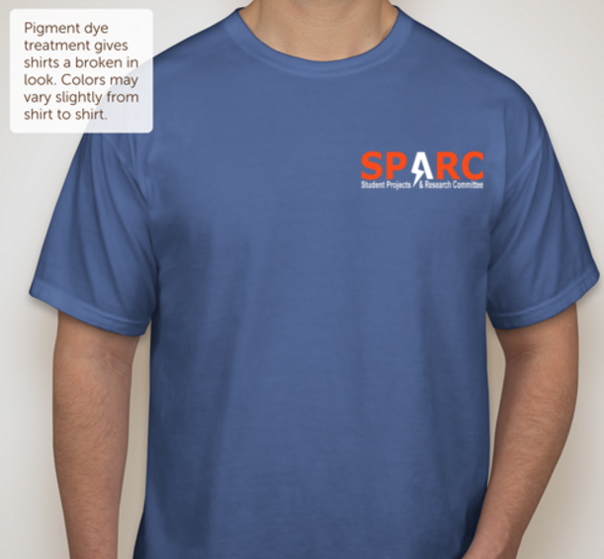

SPARC T-Shirts: Possible Design
Source: CustomInk.com

Slide 20

SPARC T-Shirts: Back Graphic

Slide 21
Maker Training Sessions
Thursday, September 22nd – Arduino/Microcontrollers
Thursday, September 29th- Raspberry Pi/Linux
Thursday, October 6th- Solidworks/3D Design
Thursday, October 13th - No Meeting for Fall Break
Thursday, October 20th- TAZ LulzBot/3D Printing
Thursday, October 27th- Github/Version Control Software
Thursday, November 3rd- Robotics/Control Systems(?)
Thursday, November 10th – Printed Circuit Board Design(?)
*meeting topics may be subject to change as needed

Slide 22
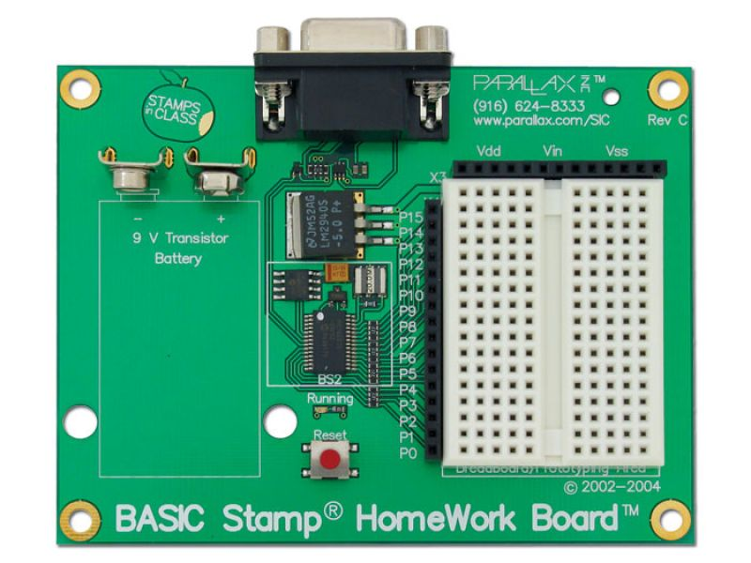
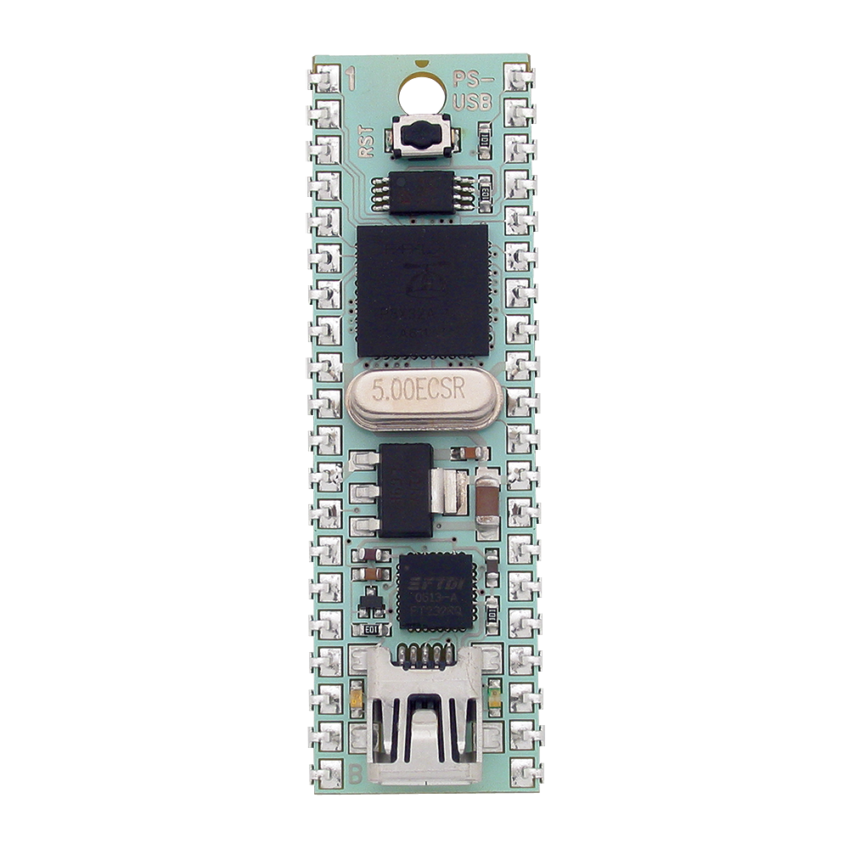
What is a Microcontroller?
A microcontroller is a simple computer on one Integrated Circuit
More economical than traditional computer boards
Are incapable of running a full operating system but can be programmed with simple programs.
Are found in many everyday electronics such as cars, toys, and appliances.
Are relatively easy to use with electrical circuits.
Parallax Basic Stamp
Arduino Uno
Parallax Propeller

Slide 23
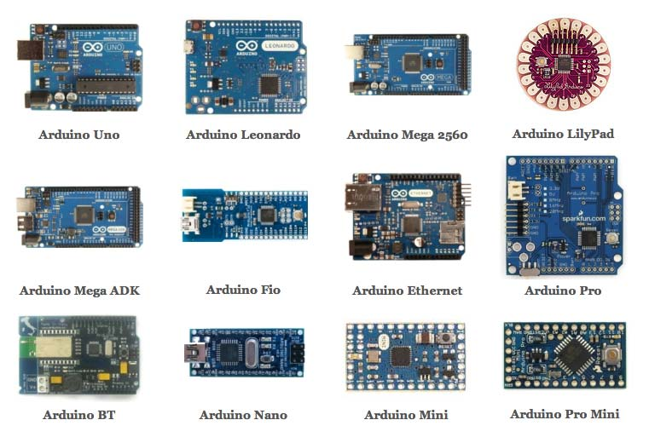
Types of Arduinos

Slide 24

Programming an Arduino
Can be programmed over USB from a computer
Uses the free Arduino IDE software
https://www.arduino.cc/en/Main/Software
Programmed in Arduino C
Has an extensive library with plenty of documentation and examples

Slide 25
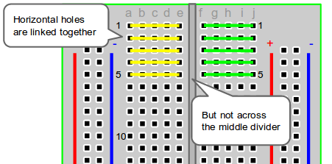
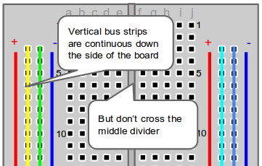
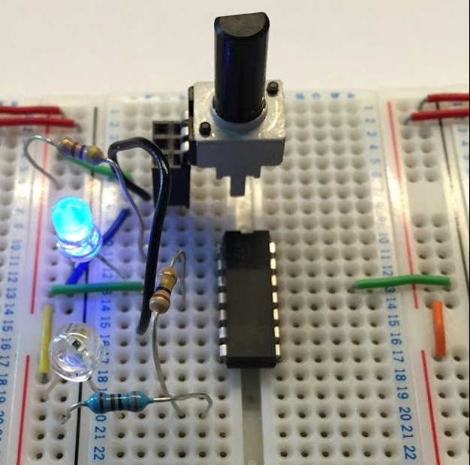
Using a Breadboard

Slide 26
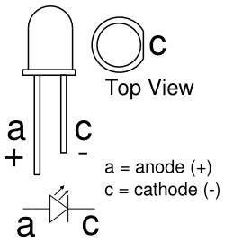
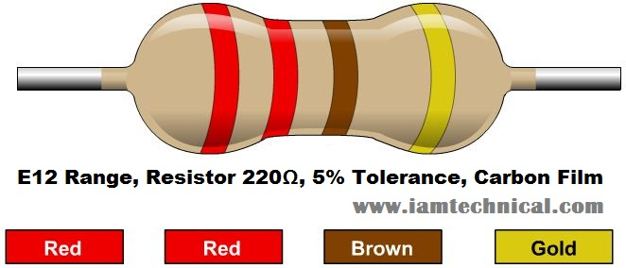

Blink an LED
It is the “Hello World” of using a microcontroller.
Connect the anode of the LED to the digital I/O pin # 13 on Arduino with a 220Ω Resistor in series.
Connect the cathode of the LED to ground (GND)
Useful Commands:
pinMode(pin, OUTPUT/INPUT);
digitalWrite(Pin, HIGH/LOW);
delay(milliseconds);

Slide 27
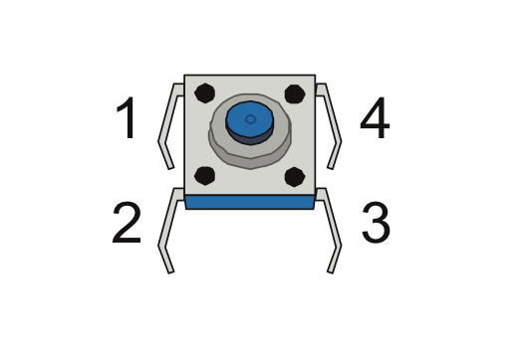
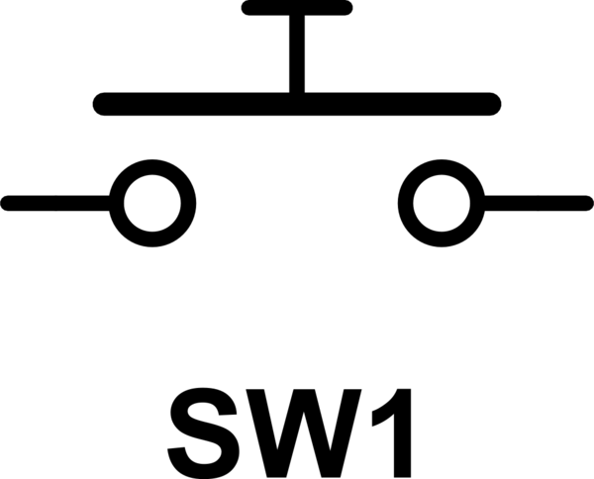
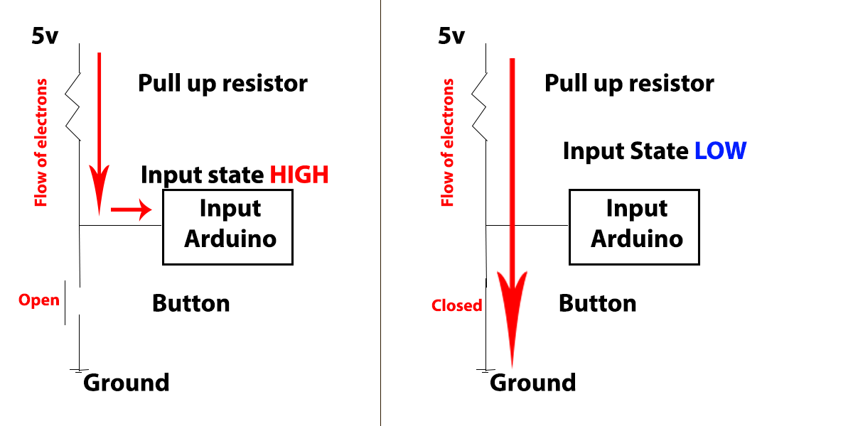
Use a Push Button
Example of Digital Input
Connect a 10kΩ resistor (Brown,Black,Orange) from the 5V to one side of the push button.
Connect IO pin 2 to the same side
Connect the other side to GND
New Commands:
INPUT_PULLUP
Serial.begin(9600);
digitalRead(pin)
Serial.println(output);

Slide 28
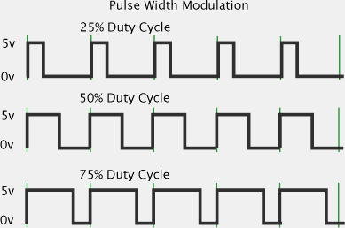
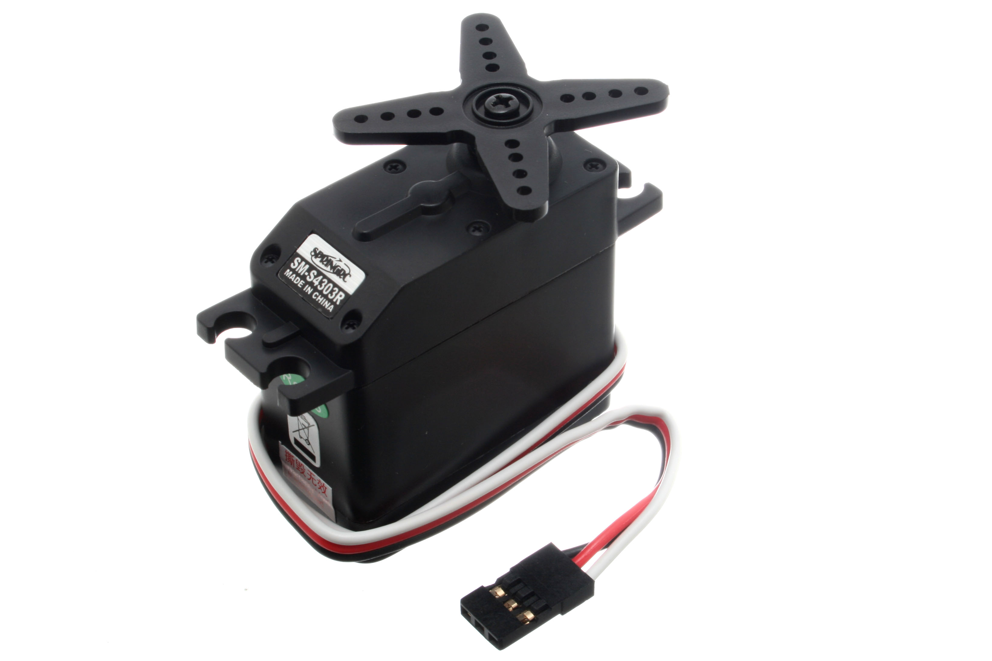
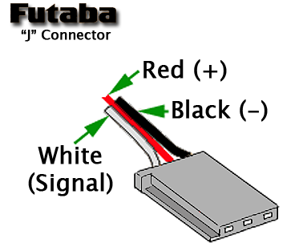
Using Servos
Example of Pulse Width Modulation
PWM is used to simulate analog signal with digital signal
Come in two main forms: Standard (180 degrees) and Continuous
Typically use a 3 pin connector
Connect white to D3
Connect red and black to 5v and GND respectively
New Commands:
#include <Servo.h>;
myservo.attach(pin);
myservo.write(integer 0-180);

Slide 29
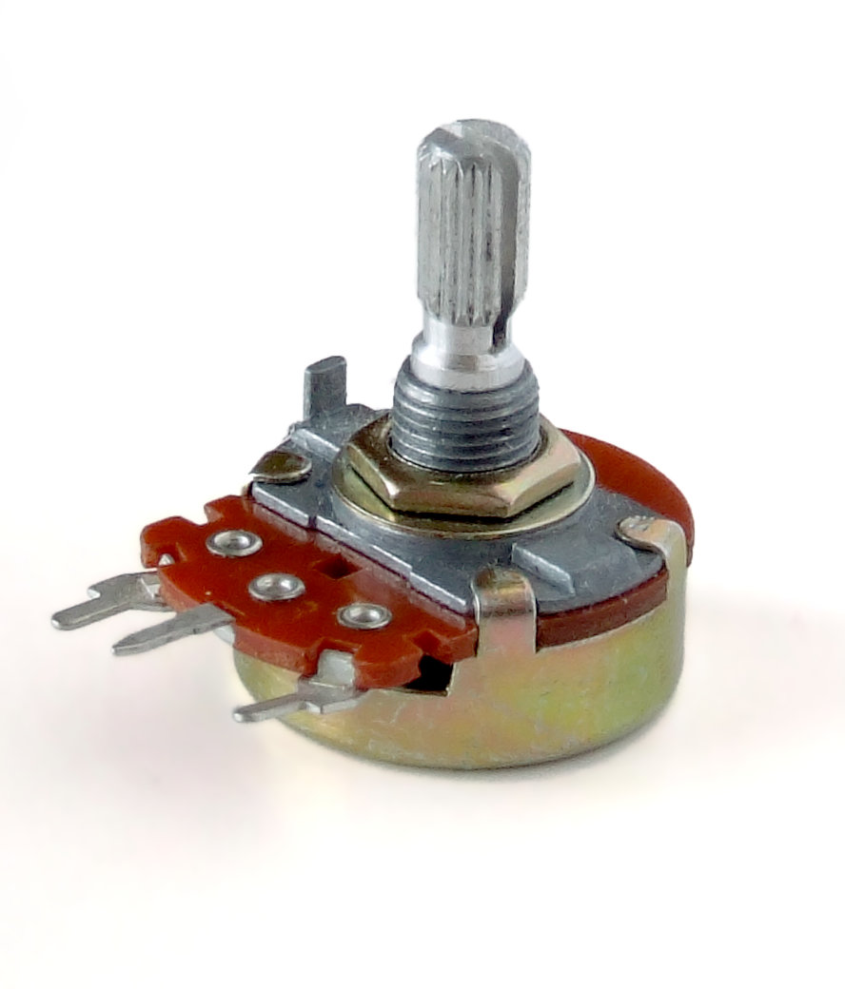
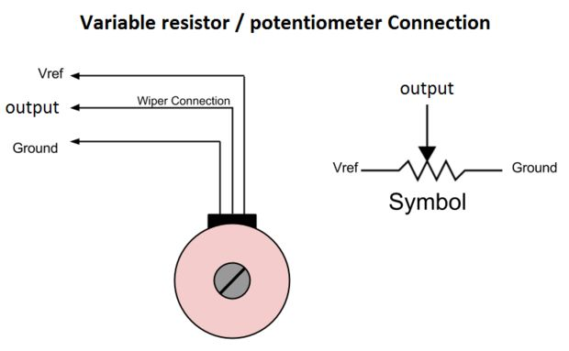
Using a Potentiometer
Example of Analog input
Is a variable Resistor
Is commonly used for volume control knobs
Used for inputting a variable value into the Arduino.
Connect center pin to A0
Connect an outer pin to 5V and the other to GND
New Commands:
analogRead(pin);

Slide 30
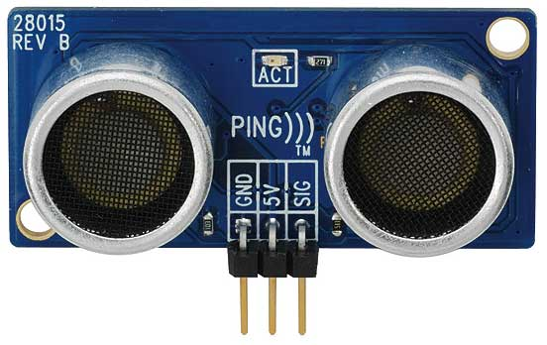
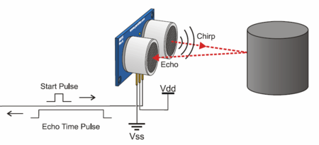
Using an Ultrasonic Sensor
Works like echolocation
Uses PWM to send out a super high pitched noise.
Detects the noise and relays the delay to the microcontroller
The distance to an object can be calculated by dividing the delay by the speed of sound by 2.
Connect to Pin 7
Use Program from Examples>Sensors>Ping

Slide 31
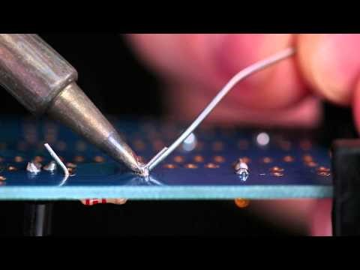
Soldering Video
https://www.youtube.com/watch?v=QKbJxytERvg&ab_channel=AdafruitIndustries

